Slide 1
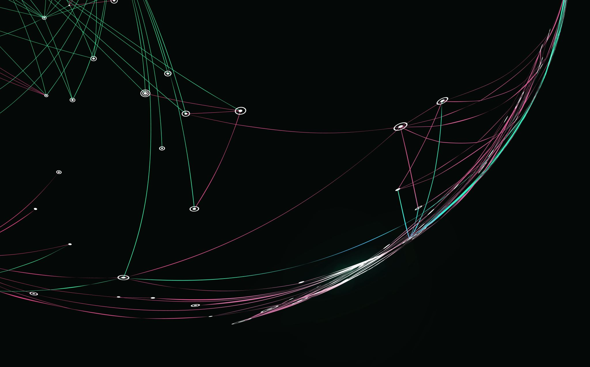
The Battle of Neighborhoods Finding a Better Place in Scarborough, Toronto

Slide 2
Purpose
The purpose of this Project is to help people in exploring better facilities around their neighborhood.
It will help people making smart and efficient decision on selecting great neighborhood out of numbers of other neighborhoods in Scarborough, Toranto.

Slide 3
Problem Description
The major purpose of this project, is to suggest a better neighborhood in a new city for the person who are shiffting there. Social presence in society in terms of like minded people. Connectivity to the airport, bus stand, city center, markets and other daily needs things nearby.
Sorted list of house in terms of housing prices in a ascending or descending order
Sorted list of schools in terms of location, fees, rating and review

Slide 4
Introduction
This Project aim to create an analysis of features for a people migrating to Scarborough to search a best neighborhood as a comparative analysis between neighborhoods. The features include median housing price and better school according to ratings, crime rates of that particular area, road connectivity, weather conditions, good management for emergency, water resources both freash and waste water and excrement conveyed in sewers and recreational facilities.
It will help people to get awareness of the area and neighborhood before moving to a new city, state, country or place for their work or to start a new fresh life.

Slide 5
Data
We used Scarborough dataset which we scrapped from wikipedia on Week 3. Dataset consisting of latitude and longitude, zip codes.
https://en.wikipedia.org/wiki/List_of_postal_codes_of_Canada:_M

Slide 6
Foursquare API Data
We will need data about different venues in different neighborhoods of that specific borough. In order to gain that information we will use "Foursquare" locational information.
Foursquare is a location data provider with information about all manner of venues and events within an area of interest. Such information includes venue names, locations, menus and even photos. As such, the foursquare location platform will be used as the sole data source since all the stated required information can be obtained through the API.
After finding the list of neighborhoods, we then connect to the Foursquare API to gather information about venues inside each and every neighborhood. For each neighborhood, we have chosen the radius to be 100 meter.

Slide 7
Data Retrieved from Foursquare
The data retrieved from Foursquare contained information of venues within a specified distance of the longitude and latitude of the postcodes. The information obtained per venue as follows:
Neighborhood
Neighborhood Latitude
Neighborhood Longitude
Venue
Name of the venue e.g. the name of a store or restaurant
Venue Latitude
Venue Longitude
Venue Category

Slide 8
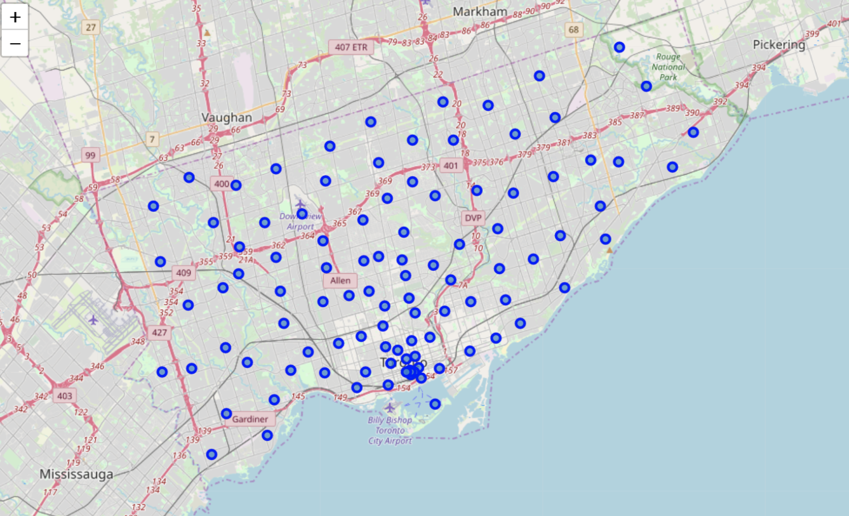
Map of Scarborough

Slide 9
Methodology
To compare the similarities of two cities, we decided to explore neighborhoods, segment them, and group them into clusters to find similar neighborhoods in a big city like New York and Toronto. To be able to do that, we need to cluster data which is a form of unsupervised machine learning: k-means clustering algorithm.

Slide 10
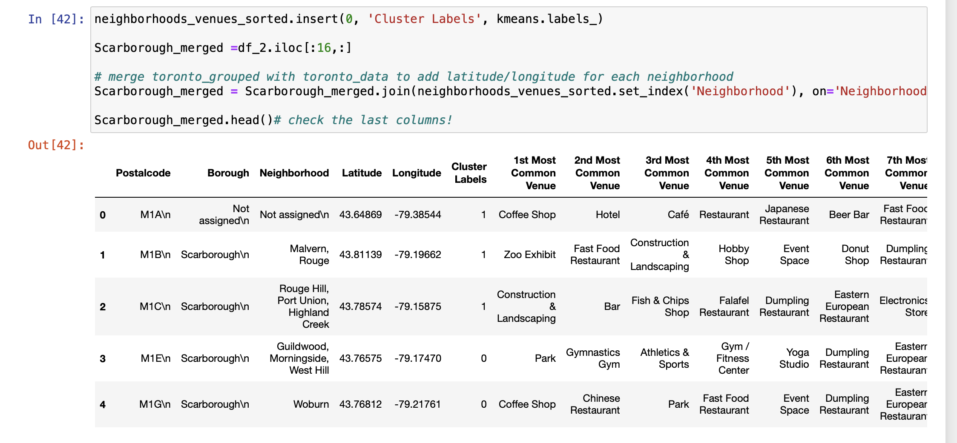
Using K-Means Clustering Approach Data

Slide 11
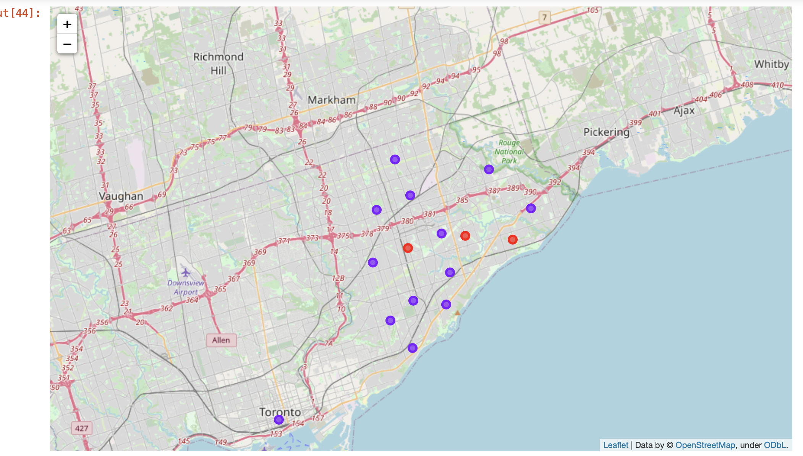
Results (Map of Clusters in Scarborough)

Slide 12
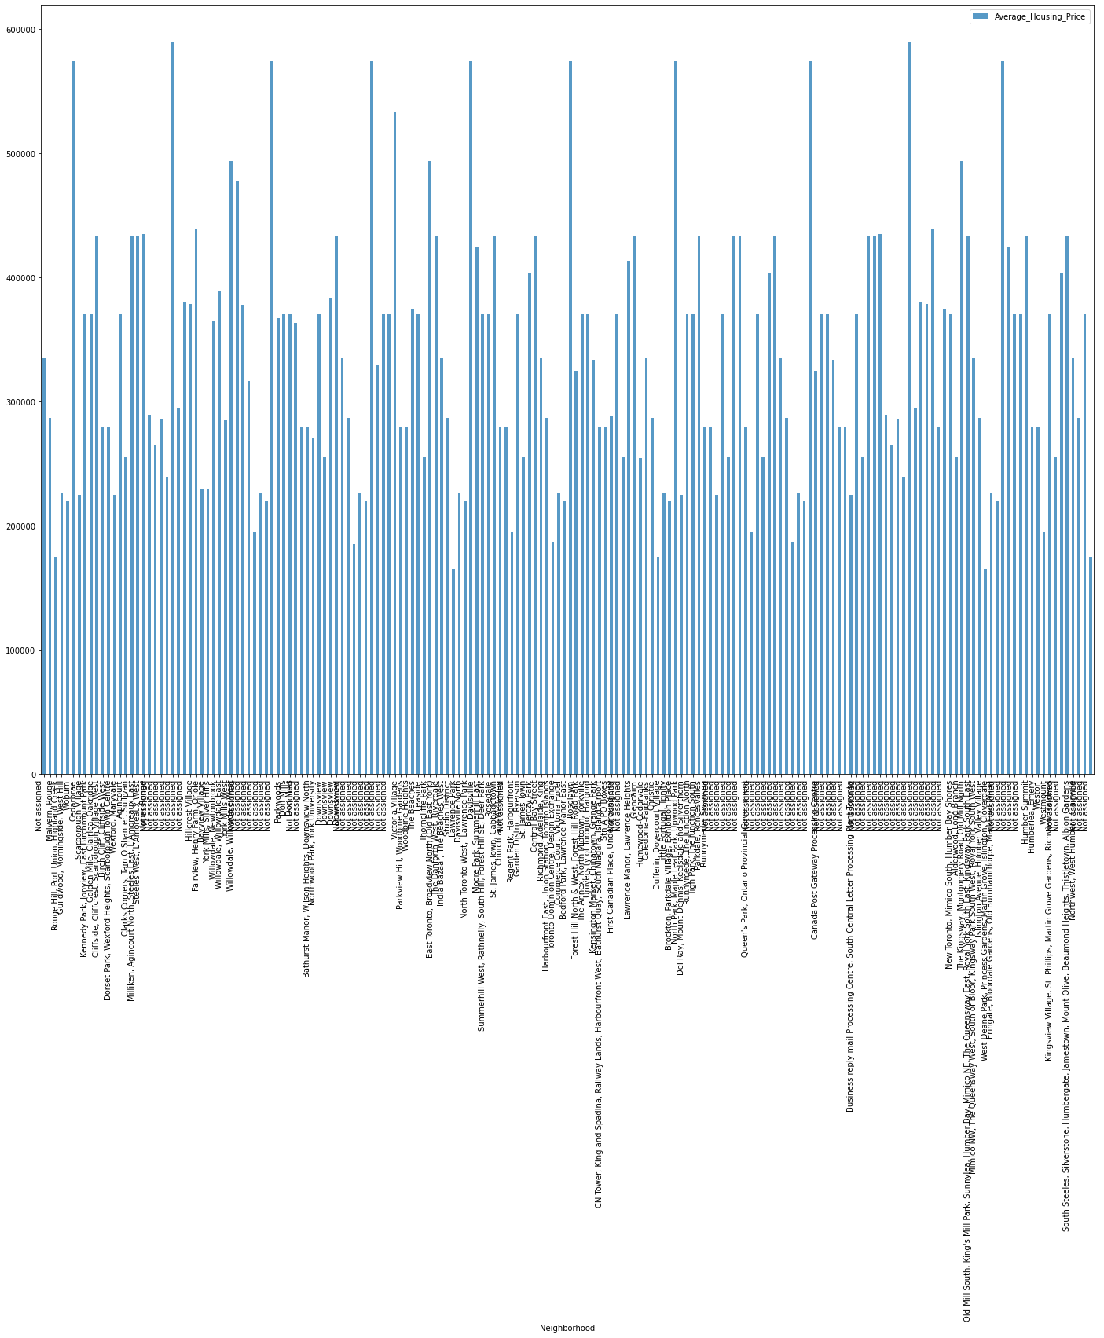
Average Housing Price by Clusters in Scarborough

Slide 13
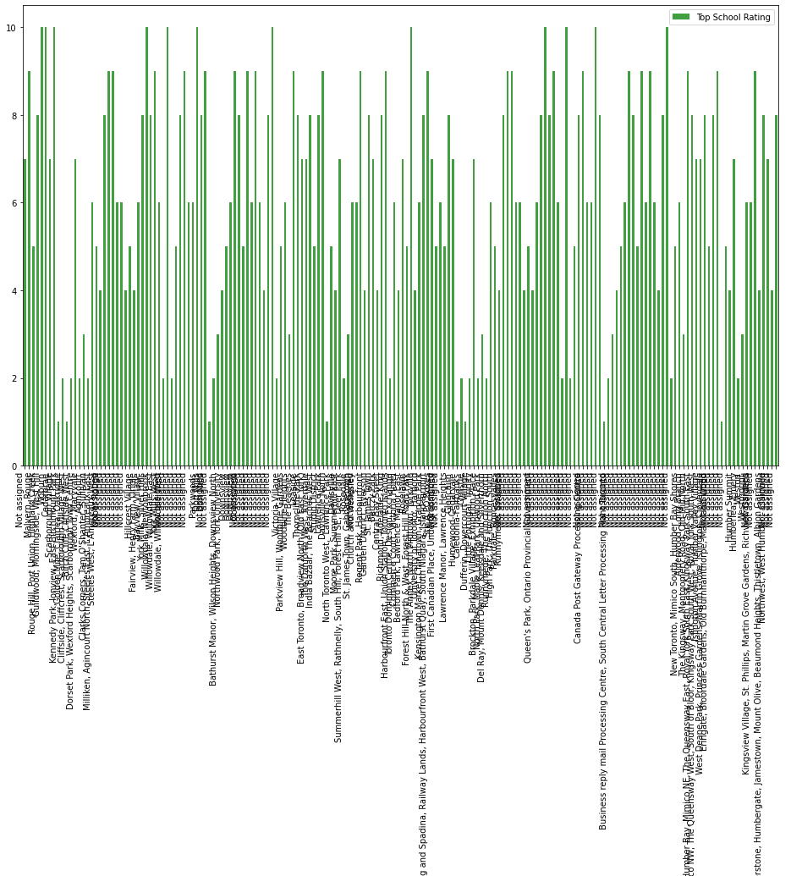
School Ratings by Clusters in Scarborough

Slide 14
Conclusion
In this project, using k-means cluster algorithm I separated the neighborhood into 10(Ten) different clusters and for 180 different lattitude and logitude from dataset, which have very-similar neighborhoods around them. Using the charts above results presented to a particular neighborhood based on average house prices and school rating have been made.

